Slide 1
ASSIGN 3
A* ALGORITHM

Slide 2
ASTAR ALGORITHM
Nehal Tanmay Alok Rajlaxmi

Slide 3
PROBLEM STATEMENT
Implement A*
Better Heuristic performs better
For h > h* , show suboptimal path
Observe Performance of Heuristics
Observe effect of Monotone restriction
Bi-directional search
Non reachability

Slide 4
IMPLEMENTATION
main.cpp : Contains call to execute function of Astar class which executes the program
astar.h : Implements general A* alogorithm
helper.h : Creates start and goal state objects depending on type of problem
state.h : implements a particular state in graph
state_list.h : Contains the definition of open list, closed list and operations performed on it.
bidirection.h : Implements class bidirection which implements bidirectional search

Slide 5
Eight Puzzle Problem
The 8 puzzle is a simple game which consists of eight sliding tiles, labeled with pieces of a image, placed in a 3x3 squared board of nine cells.
One of the cells is always empty, and any adjacent (horizontally and vertically) tile can be moved into the empty cell.
The objective of game is to start from an initial configuration and end up in a configuration in which tiles are placed in ascending order.
State Representation:
In order to use heuristic 3x3 matrix is represented in row major form
e.g : 1 2 3
4 5 6
7 8 0
is represented as 123456780

Slide 6
Performance of Heuristics: Eight Puzzle
Performance can be measured in terms of no of nodes expanded to reach goal state
Admissible Heuristics:
Manhattan Distance
Sum of Euclidean Distance
No of tiles out of row + No of tiles out of column
Displaced Tile
Base Figure (h = 0)
Sub optimal Heuristics:
h += abs(k-i+13) + abs(j-l+13)
h += 10*pow(abs(k-i),15) + 10*pow(abs(j-l),15)

Slide 7
Comparison of heuristics
Case 1:
(436218705-123456780)
Nodes Expanded:60
Nodes Visited:107
Case 2:
(123804756-123456780)
Nodes Expanded:170
Nodes Visited:298
Case 3:
(102453678- 123456780)
Nodes Expanded:202
Nodes Visited:348
Manhattan
Case 1:
(436218705-123456780)
Nodes Expanded: 14
Nodes Visited: 26
Case 2:
(123804756-123456780)
Nodes Expanded: 81
Nodes Expanded: 139
Case 3:
(102453678- 123456780)
Nodes Expanded: 73
Nodes Visited: 130
Displaced Tile
Case 1:
(436218705-123456780)
Nodes Expanded: 60
Nodes Visited: 107
Case 2:
(123804756-123456780)
Nodes Expanded:170
Nodes Visited: 298
Case 3:
(102453678- 123456780)
Nodes Expanded: 202
Nodes Visited: 348
Baseline (h = 0)
Case 1:
(123458670- 436218705)
Nodes Expanded: 1589
Nodes Visited: 2649
Case 2:
(123458670- 123804756)
Nodes Expanded: 2619
Nodes Visited: 4520
Case 3: (102453678-123456780)
Nodes Expanded: 2967
Nodes Visited: 5314

Slide 8
Comparison of heuristics
Case 1:
(436218705-123456780)
Nodes Expanded:60
Nodes Visited:107
Case 2:
(123804756-123456780)
Nodes Expanded:170
Nodes Visited:298
Case 3:
(102453678- 123456780)
Nodes Expanded:202
Nodes Visited:348
Manhattan
Case 1:
(436218705-123456780)
Nodes Expanded: 14
Nodes Visited: 26
Case 2:
(123804756-123456780)
Nodes Expanded: 81
Nodes Expanded: 139
Case 3:
(102453678- 123456780)
Nodes Expanded: 73
Nodes Visited: 130
Euclidean Dist.
Case 1:
(436218705-123456780)
Nodes Expanded: 16
Nodes Visited: 30
Case 2:
(123804756-123456780)
Nodes Expanded: 81
Nodes Visited: 139
Case 3:
(102453678- 123456780)
Nodes Expanded: 75
Nodes Visited: 135
Baseline (h = 0)
Case 1:
(123458670- 436218705)
Nodes Expanded: 1589
Nodes Visited: 2649
Case 2:
(123458670- 123804756)
Nodes Expanded: 2619
Nodes Visited: 4520
Case 3: (102453678-123456780)
Nodes Expanded: 2967
Nodes Visited: 5314

Slide 9
Comparison of heuristics
Case 1:
(436218705-123456780)
Nodes Expanded:60
Nodes Visited:107
Case 2:
(123804756-123456780)
Nodes Expanded:170
Nodes Visited:298
Case 3:
(102453678- 123456780)
Nodes Expanded:202
Nodes Visited:348
Manhattan
Case 1:
(436218705-123456780)
Nodes Expanded: 14
Nodes Visited: 26
Case 2:
(123804756-123456780)
Nodes Expanded: 81
Nodes Expanded: 139
Case 3:
(102453678- 123456780)
Nodes Expanded: 73
Nodes Visited: 130
No of tiles out of row, out of column
Case 1:
(436218705-123456780)
Nodes Expanded: 14
Nodes Visited: 26
Case 2:
(123804756-123456780)
Nodes Expanded: 87
Nodes Visited: 149
Case 3:
(102453678- 123456780)
Nodes Expanded: 93
Nodes Visited: 167
Baseline (h = 0)
Case 1:
(123458670- 436218705)
Nodes Expanded: 1589
Nodes Visited: 2649
Case 2:
(123458670- 123804756)
Nodes Expanded: 2619
Nodes Visited: 4520
Case 3: (102453678-123456780)
Nodes Expanded: 2967
Nodes Visited: 5314

Slide 10
Observation
In Admissible heuristic Manhattan distance expands the least number of nodes.
Admissible heuristic always finds optimal path and may take longer time to find path than non-admissible heuristic.
From figures it is clear that performance is in order:
Manhattan > Euclidean Distance > Out of row + Out of column > Displaced Tile > Baseline

Slide 11
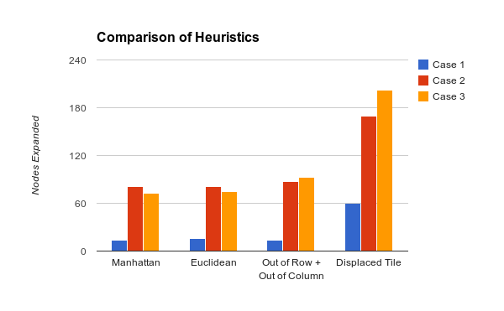
Comparison of Heuristics

Slide 12
Solvability of Eight puzzle
A state is reachable from another state if parity of both states are same.
For computing parity write 3x3 matrix in row-major order
E.g
123458670
Calculate no of inversions = 2 (8,6 and 8,7 are inverted)
Parity = 2%2 = 0
We can reach states of even parity from this state.

Slide 13
Further Observations
Since Manhattan and Displaced Tile and baseline is monotone, no parent pointer redirection is there
Euclidean distance and out of row out of column are also monotone for 8 puzzle so no parent pointer redirection is observed

Slide 14
Utility of MR demoed
test case: (123804756-123456780)
Manhattan Length:13
Nodes Expanded: 81
Nodes Expanded:139
Redirections: 0
Random Heuristic1:
h+= abs(k-i+13)+abs(j-i+13)
Length: 23
Nodes Expanded: 207
Nodes Visited: 360
Redirections: 6
DisplaceTile Length:13
Nodes Expanded:170
Nodes Visited:298
Redirections: 0
Random Heuristic2:
h +=10*pow(abs(k-i),15)+ 10*pow(abs(j-l),15)
Length: 19
Nodes Expanded: 757
Nodes Visited: 1308
Redirections: 157

Slide 15
Sub Optimal Heuristics
Random Heuristic 1: h += abs(k-i+13) + abs(j-l+13)
Random Heuristic 2 : h += 10*pow(abs(k-i),15) + 10*pow(abs(j-l),15)

Slide 16
Comparison of Optimal and Suboptimal Heuristics​
Case 1:
(436218705-123456780)
Nodes Expanded:60
Nodes Visited:107
Case 2:
(123804756-123456780)
Nodes Expanded:170
Nodes Visited:298
Case 3:
(102453678- 123456780)
Nodes Expanded:202
Nodes Visited:348
Manhattan
Case 1:​
(436218705-123456780)​
Distance: 12
No of nodes expanded: 14​
No of nodes visited: 26
Case 2:​
(123804756-123456780)​
Distance: 13
No of nodes expanded: 81
No of nodes visited: 139
Case 3:​
(102453678- 123456780)​
Distance:​ 14
No of nodes expanded:​ 73
No of nodes visited:​ 130
Random Heuristic 1​
Case 1:​
(436218705-123456780)​
Distance: 52
No of nodes expanded: 2228
No of nodes visited: 3611
Case 2:​
(123804756-123456780)​
Distance: 23
No of nodes expanded: 201​
No of nodes visited: 348
Case 3:​
(102453678- 123456780)​
Distance: 30​
No of nodes expanded: 458​
No of nodes visited: 780
Random Heuristic 2​
Case 1:​
(436218705-123456780)​
Distance:​ 12
No of nodes expanded:​ 12
No of nodes visited:​ 23
Case 2:​
(123804756-123456780)​
Distance: 19
No of nodes expanded: 2618
No of nodes visited: 4130
Case 3:​
(102453678- 123456780)​
Distance: 24
No of nodes expanded: 1660
No of nodes visited: 2719
​
​

Slide 17
Comparison of Optimal and Suboptimal Heuristics​
Case 1:
(436218705-123456780)
Nodes Expanded:60
Nodes Visited:107
Case 2:
(123804756-123456780)
Nodes Expanded:170
Nodes Visited:298
Case 3:
(102453678- 123456780)
Nodes Expanded:202
Nodes Visited:348
Manhattan
Case 1:​
(436218705-123456780)​
Distance: 12
No of nodes expanded: 14​
No of nodes visited: 26
Case 2:​
(123804756-123456780)​
Distance: 13
No of nodes expanded: 81
No of nodes visited: 139
Case 3:​
(102453678- 123456780)​
Distance:​ 14
No of nodes expanded:​ 73
No of nodes visited:​ 130
Space considered as tile​
Case 1:​
(436218705-123456780)​
Distance: 12
No of nodes expanded: 24
No of nodes visited: 44
Case 2:​
(123804756-123456780)​
Distance: 13
No of nodes expanded: 93
No of nodes visited: 161
Case 3:​
(102453678- 123456780)​
Distance: 14
No of nodes expanded: 124
No of nodes visited: 212

Slide 18
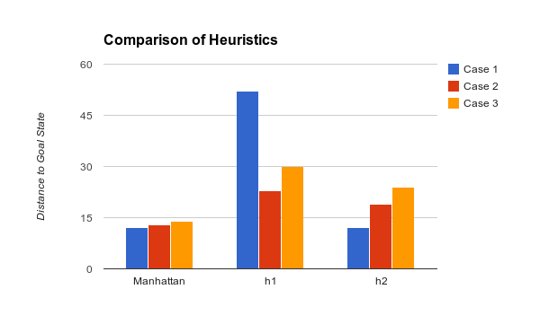
Comparison of Heuristics

Slide 19
Observation:​
From above Data we can conclude :​
Sub optimal Heuristic may finds path which has greater distance between start and goal state than Admissible heuristic.​
It may or may not converge at a faster rate(no of nodes expanded) than optimal heuristic depending on the heuristic​

Slide 20
Bidirectional Search
Bidirectional search does not produce optimal path every time
Reason: When two directional search meet at a node, its not necessary that the path is optimal because h-value is not exact
With baseline heuristic (h = 0), optimal path is discovered and no of nodes expanded are less than normal search
Reason: This is because any time point of time the f value of at any node is equal to the actual cost of node and there is no estimation to goal (h = 0)
Whenever two directional searches meet at a node shortest path has to be found because path found after this are going to be greater than or equal to length of this path

Slide 21
Bidirection Performance​ Displaced Heuristic​
Without Bidirection​
Case 1:​
(123804756-123456780)​
Length: 12
Nodes Expanded: 91
Nodes Visited: 161
​
Case 2:​436218705-123456780
(013426758-123456780)​
Length: 12
Nodes Expanded: 60
Nodes visited: 107
​
With Bidirection​
Case 1:​
Length: 12
start to meet: 6
meet visited: 6
Nodes Expanded: 44
Nodes Visited: 76
​
Case 2:​
Length:12
start to meet: 5
meet visited: 7
Nodes Expanded: 56
Nodes Visited: 99

Slide 22
Bidirection Performance​ Manhattan Heuristic​
Without Bidirection​
Case 1:​
(123804756-123456780)​
Distance between Start and Goal: 12
Nodes Expanded: 47
Nodes Visited: 83
​
Case 2:​
(436218705-123456780)​
Distance between Start and Goal: 12​
Nodes Expanded: 14​
Nodes Expanded: 26​
​
With Bidirection​
Case 1:​
Distance between Start and Goal: 12
start to meet: 5
meet visited: 7
Nodes Expanded: 40
Nodes Visited: 71
​
Case 2:​
Length:12​
start to meet: 6
meet visited: 6
Nodes Expanded:12
Nodes Visited: 21

Slide 23
Bidirection Performance​ Base Heuristic​
Without Bidirection​
Case 1:​
(123804756-123456780)​
Distance between Start and Goal: 12
Nodes Expanded: 1275
Nodes Visited: 2250
​
Case 2:​
(436218705-123456780)​
Distance between Start and Goal: 12
Nodes Expanded: 1589​
Nodes Expanded: 2649​
​
With Bidirection​
Case 1:​
Distance between Start and Goal: 12
start to meet: 6
meet visited: 6
Nodes Expanded: 90
Nodes Visited: 153
​
Case 2:​
Length: 12​
start to meet: 6
meet visited: 6
Nodes Expanded: 84
Nodes Visited: 150

Slide 24
Performance with Bidirection​
From above data we can conclude:​
With Bidirection enabled, there is no guarantee for an optimal path​
No of nodes expanded (time for convergence) will be lower than without bidirection​
No of nodes is usually greater than without bidirection because nodes are seen from both the sides during search​
For baseline heuristic (h = 0) optimal path will be found always but no of nodes expanded and seen will be greater than without bidirection​
​

Slide 25
Missionaries and Cannibals​
Problem Statement
The 'missionaries and cannibals' is a simple puzzle which consists of n missionaries and n cannibals at left side of river with a single boat wanted to cross the river​
The boat can carry at most two people​
If there are missionaries present on the bank, they cannot be outnumbered by cannibals​
State Representation:​
Tuple containing 3 entries, no. of missionaries and cannibals on left bank of river and current position of boat​
e.g. <3,3,L> ​

Slide 26
Performance of Heuristics: Missionaries and Cannibals​
Performance can be measured in terms of no of nodes expanded to reach goal state​
​
Admissible Heuristics:​
Number of people on Initial Side (h1)​
Number of people on Initial Side / 2 (h2)​
Base Figure (h = 0) (h3)​
Sub optimal Heuristics:​
h = h1*3
h = (missionaries^2)*13 + (cannibals^3)

Slide 27
Comparison of Admissible heuristics​
Case 1:
(436218705-123456780)
Nodes Expanded:60
Nodes Visited:107
Case 2:
(123804756-123456780)
Nodes Expanded:170
Nodes Visited:298
Case 3:
(102453678- 123456780)
Nodes Expanded:202
Nodes Visited:348
h1​
Case1: ​
(<3,3,L> - <0,0,R>) ​
Nodes Expanded: 26​
Nodes Visited:29​
Case 2:​
(<3,3,L> - <1,1,R>)​
Nodes Expanded:12​
Nodes Expanded:13​
h2
Case1: ​
(<3,3,L> - <0,0,R>)​
Nodes Expanded: 29​
Nodes Visited: 32​
Case 2:​
(<3,3,L> - <1,1,R>)​
Nodes Expanded:13​
Nodes Expanded:14​
h3
Case1: ​
(<3,3,L> - <0,0,R>)​
Nodes Expanded: 29​
Nodes Visited: 32​
Case 2:​
(<3,3,L> - <1,1,R>)​
Nodes Expanded:13​
Nodes Expanded:14​

Slide 28
Observations​
In Admissible heuristic h1 expands the least number of nodes. Admissible heuristic always finds optimal path and takes larger time to find path than non-admissible heuristic.​
​
From figures it is clear that performance is in order:​
h1 > h2 >= Baseline (h3)​
​

Slide 29
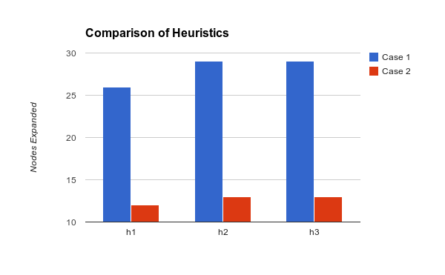
Comparison of Heuristics

Slide 30
h > h*​
For heuristic h = no of people on initial side
No of Nodes visited State: 12​
Nodes Expanded: 26​
Nodes Visited: 29​
​
For heuristic: h*3​
No of Nodes visited State: 12​
Nodes Expanded: 21​
Nodes Visited: 23​
For heuristic: h= (missionaries^2)*13 + (cannibals^3)
No of Nodes visited State: 12​
Nodes Expanded: 17
Nodes Visited: 19
Here last two heuristics converge faster

Slide 31
Bidirection Performance​ h = no of people on initial side
Without Bidirection​
​
Distance between Start and Goal: 12
Nodes Expanded: 29
Nodes Visited: 32
​
With Bidirection​
Case 1:​
Distance between Start and Goal: 12
start to meet: 7
meet visited: 5
Nodes Expanded: 20
Nodes Visited: 21
​

Slide 32
Bidirection Performance​ h = no of people on initial side / 2
Without Bidirection​
​
Distance between Start and Goal: 12
Nodes Expanded: 26
Nodes Visited: 29
​
With Bidirection​
Case 1:​
Distance between Start and Goal: 12
start to meet: 7
meet visited: 5
Nodes Expanded: 20
Nodes Visited: 21
​

Slide 33
Bidirection Performance​ h = 0
Without Bidirection​
​
Distance between Start and Goal: 12
Nodes Expanded: 29
Nodes Visited: 32
​
With Bidirection​
Case 1:​
Distance between Start and Goal: 12
start to meet: 7
meet visited: 5
Nodes Expanded: 20
Nodes Visited: 22
​

